Slide 1
高等机器学习
Advanced Machine Learning
§2 神经网络优化
Optimization for neural networks
烨烨子
上海财经大学
www.tengjiaye.com
高等机器学习 Advanced Machine Learning
机器学习 Machine Learning
滕佳烨 Jiaye Teng, 上海财经大学 SUFE

Slide 2
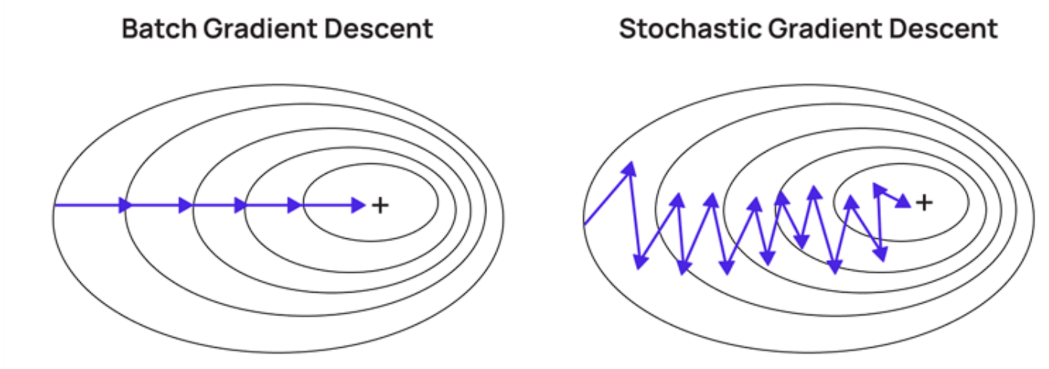
Stochastic Gradient Descent
To calculate the best parameters that would optimistically minimize the Loss Function, Gradient Descent algorithm is developed.
However, due to its cost of computational resources, a better version of which is proposed
高等机器学习 Advanced Machine Learning
机器学习 Machine Learning
滕佳烨 Jiaye Teng, 上海财经大学 SUFE

Slide 3
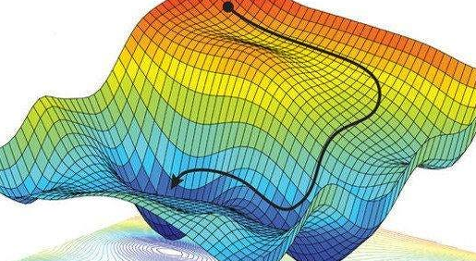
Stochastic Gradient Descent
However, optimize a non-convex problem analytically could be an NP-hard problem, the difficulty comes from two perspectives:
a non-convex function may have many local minima, and it might be hard to find the best one (global minimum) among them.
even finding a local minimum might be hard as there can be many tricky “Saddle Points”(Stationary, yet non-minima/maxima)
高等机器学习 Advanced Machine Learning
机器学习 Machine Learning
滕佳烨 Jiaye Teng, 上海财经大学 SUFE

Slide 4
Saddle Point in Non-convex Optimization
Applying the Hessian matrix could, in principle, alleviate this issue. However this usually increases the memory requirement and computation time per iteration.
Apart from that, this paper also proposed an alternative choice, by answering:
Question: Given a non-convex function with many saddle points, what properties of it will guarantee stochastic gradient descent to converge to a local minimum efficiently?
高等机器学习 Advanced Machine Learning
机器学习 Machine Learning
滕佳烨 Jiaye Teng, 上海财经大学 SUFE

Slide 5
Saddle Point in Non-convex Optimization
This problem is generally solve by this proven theorem:
Suppose f(w) is strict saddle, Noisy Gradient Descent outputs a point that is close to a local minimum in polynomial number of steps.
The idea could be generalized/broaden into solving the orthogonal tensor decomposition problem. By proving:
Given random samples X such that T = E[g(X)] is an orthogonal 4-th order tensor, there is an objective function f(w) = E[φ(w,X)], such that every local minimum of f(w) corresponds to a valid decomposition of T.
高等机器学习 Advanced Machine Learning
机器学习 Machine Learning
滕佳烨 Jiaye Teng, 上海财经大学 SUFE

Slide 6
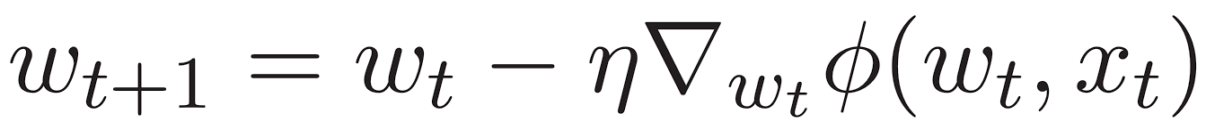
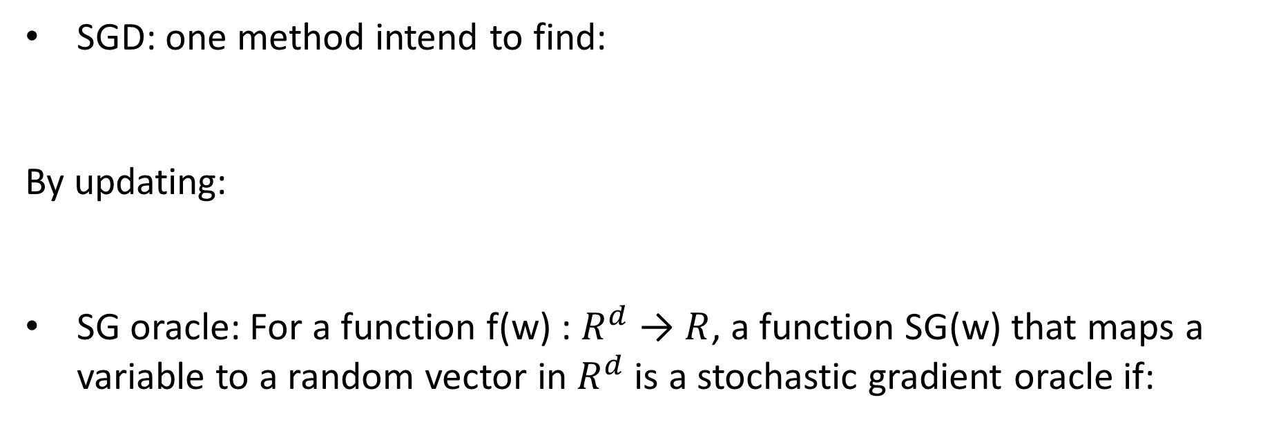
Preliminaries
SGD: one method intend to find:
By updating:
SG oracle: For a function f(w) : $R^{d}$ → $R$, a function SG(w) that maps a variable to a random vector in $R^{d}$ is a stochastic gradient oracle if:
高等机器学习 Advanced Machine Learning
机器学习 Machine Learning
滕佳烨 Jiaye Teng, 上海财经大学 SUFE

Slide 7
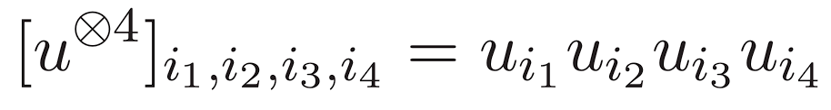
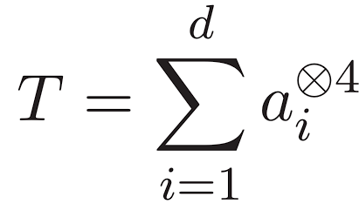
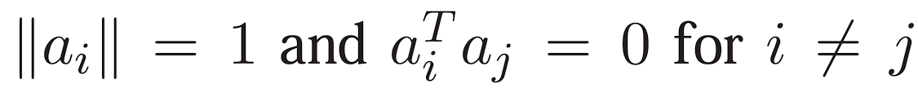
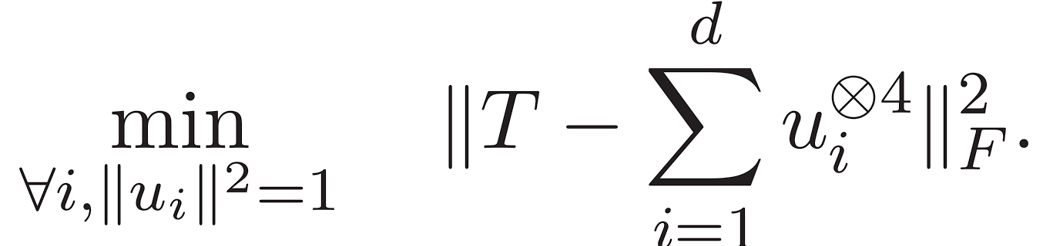
Preliminaries
Tensor decomposition: tensors can be generated by tensor products, a 4th order tensor comes in the form of
Describing one tensor of having orthogonal decomposition by
And the objective is measured by reconstruction error:
Multilinear form: just as how a bilinear form correspond to an matrix, a tensor has its corresponding multilinear form, similarly defined
高等机器学习 Advanced Machine Learning
机器学习 Machine Learning
滕佳烨 Jiaye Teng, 上海财经大学 SUFE

Slide 8
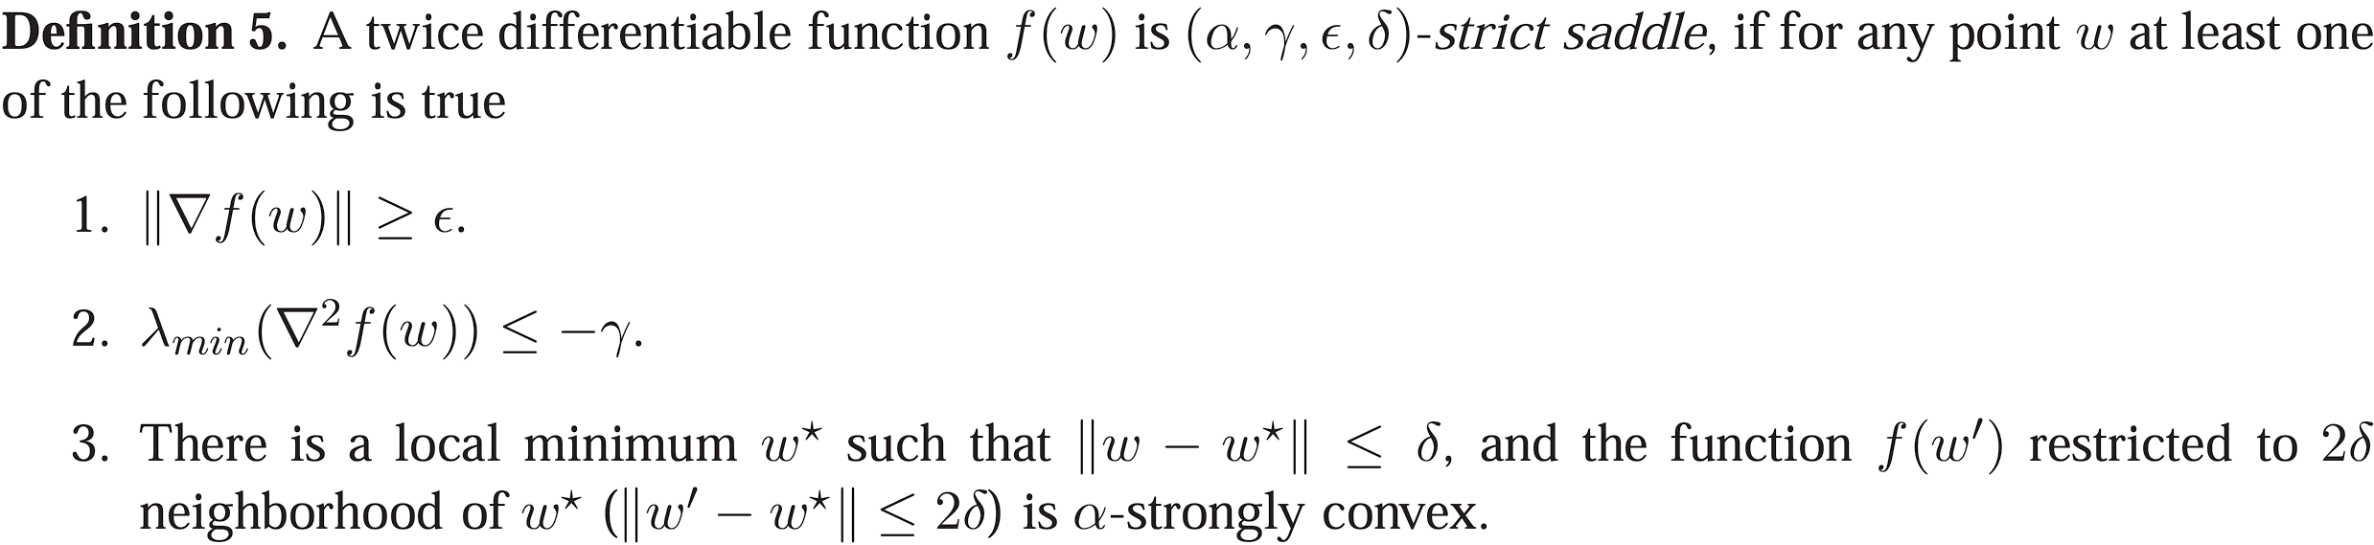
Strict Saddle
The quick convergence proposed by this paper is guaranteed by a “strict saddle” property, such that:
Lets bring it down step-by-step.
高等机器学习 Advanced Machine Learning
机器学习 Machine Learning
滕佳烨 Jiaye Teng, 上海财经大学 SUFE

Slide 9


Strict Saddle
Gradient requirement: for a $β$-smooth, bounded function $f(ω)$, if the gradient of which: $\left|\left|∇f\left(ω\right)\right|\right|≥C\sqrt{η }\left(C=\tilde{Θ}\left(1\right)\right).$ And $C\sqrt{η }≤ϵ$, each iteration would converge quick enough that:
Local minima: for any point $ω_{t}$ that is closed enough to a real minima $ω^{∗}$: $\tilde{O}\left(\sqrt{η}\right)<δ$, then in $\tilde{O}\left(η^{−2}log⁡(1/ζ)\right)$, all future steps will be $\tilde{O}\left(\sqrt{ηlog⁡(\frac{1}{ηζ})}\right)$ close with probability at least (1-$\frac{ζ}{2}$)
高等机器学习 Advanced Machine Learning
机器学习 Machine Learning
滕佳烨 Jiaye Teng, 上海财经大学 SUFE

Slide 10

Strict Saddle
Saddle enough: if the gradient for any $ω_{t}$: $\left|\left|∇f\left(ω_{t}\right)\right|\right|≤C\sqrt{η }\left(C=\tilde{Θ}\left(1\right)\right).$ And with the minimal eigenvalue of Hessian of $λ_{min}\left(∇^{2}f\left(ω_{t}\right)\right)≤−γ$, then in number of steps T, the function would be minimized quick enough $𝔼\left[f\left(ω_{t+T}\right)\right]≤$ $f\left(ω_{t}\right) − \tilde{Ω(η)}$, where T is also upper bounded by $T_{max}=\tilde{O}(1/η)$
The hope of the algorithm is that the additional (or inherent) noise in the update step makes a small step towards the correct direction, and the future updates will “slide” down the saddle.
高等机器学习 Advanced Machine Learning
机器学习 Machine Learning
滕佳烨 Jiaye Teng, 上海财经大学 SUFE

Slide 11
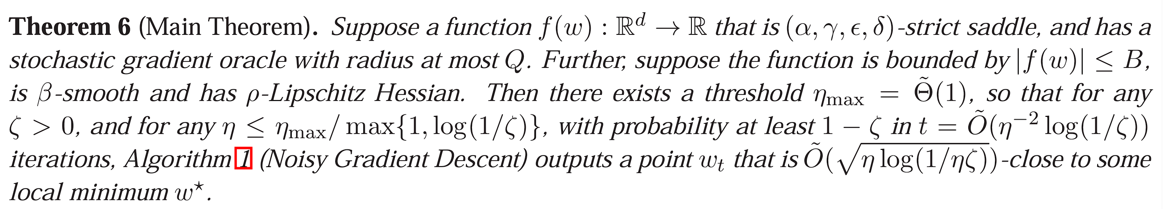

Main Theorem
Given the sufficient condition of ($α,γ,ε,δ$)-strict saddle, one would conduct that:
Which implies a convergence efficient enough.
高等机器学习 Advanced Machine Learning
机器学习 Machine Learning
滕佳烨 Jiaye Teng, 上海财经大学 SUFE

Slide 12
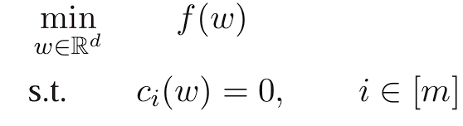
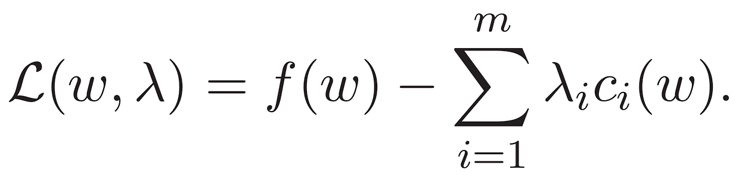
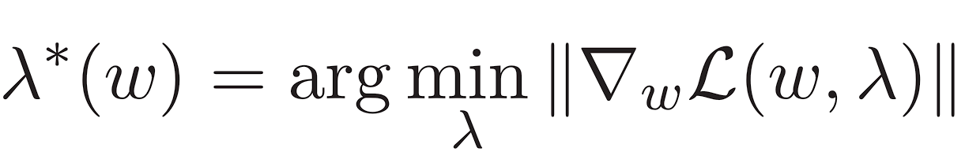
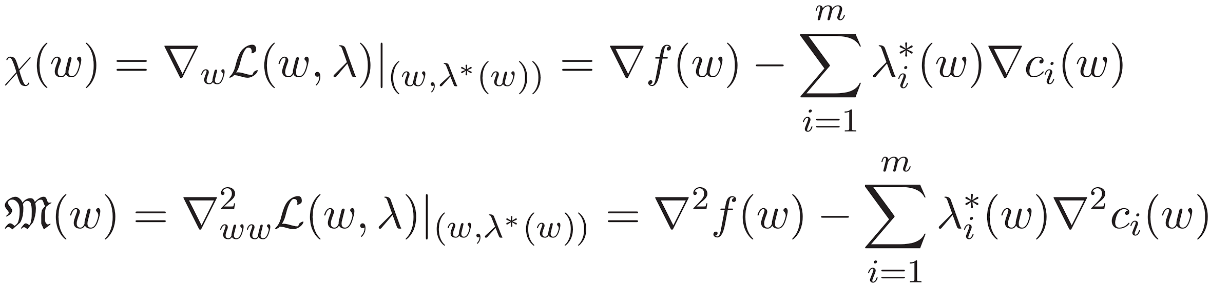
Constrained scenario
A constrained problem would convert the issue into:
For constrained problem, it is common to consider the Lagrangian and multiplier:
Which convert the first/second order into:
高等机器学习 Advanced Machine Learning
机器学习 Machine Learning
滕佳烨 Jiaye Teng, 上海财经大学 SUFE

Slide 13
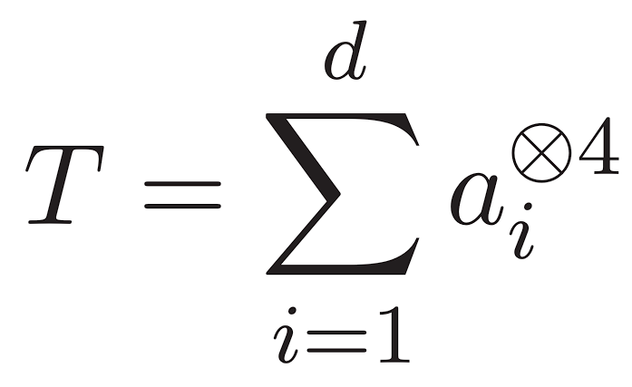
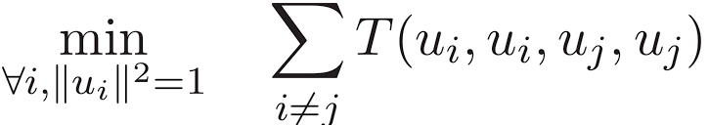
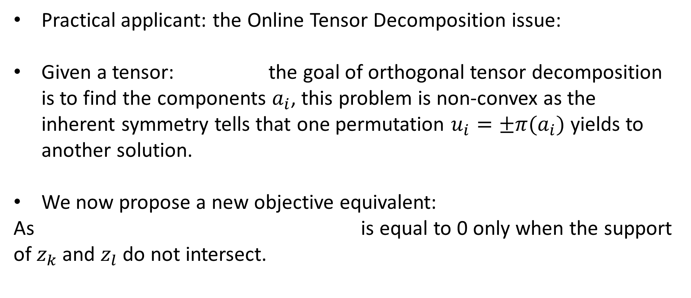
Tensor Decomposition
Practical applicant: the Online Tensor Decomposition issue:
Given a tensor: the goal of orthogonal tensor decomposition is to find the components $a_{i}$, this problem is non-convex as the inherent symmetry tells that one permutation $u_{i}=±{π(a}_{i})$ yields to another solution.
We now propose a new objective equivalent:
As is equal to 0 only when the support of $z_{k}$ and $z_{l}$ do not intersect.
高等机器学习 Advanced Machine Learning
机器学习 Machine Learning
滕佳烨 Jiaye Teng, 上海财经大学 SUFE

Slide 14
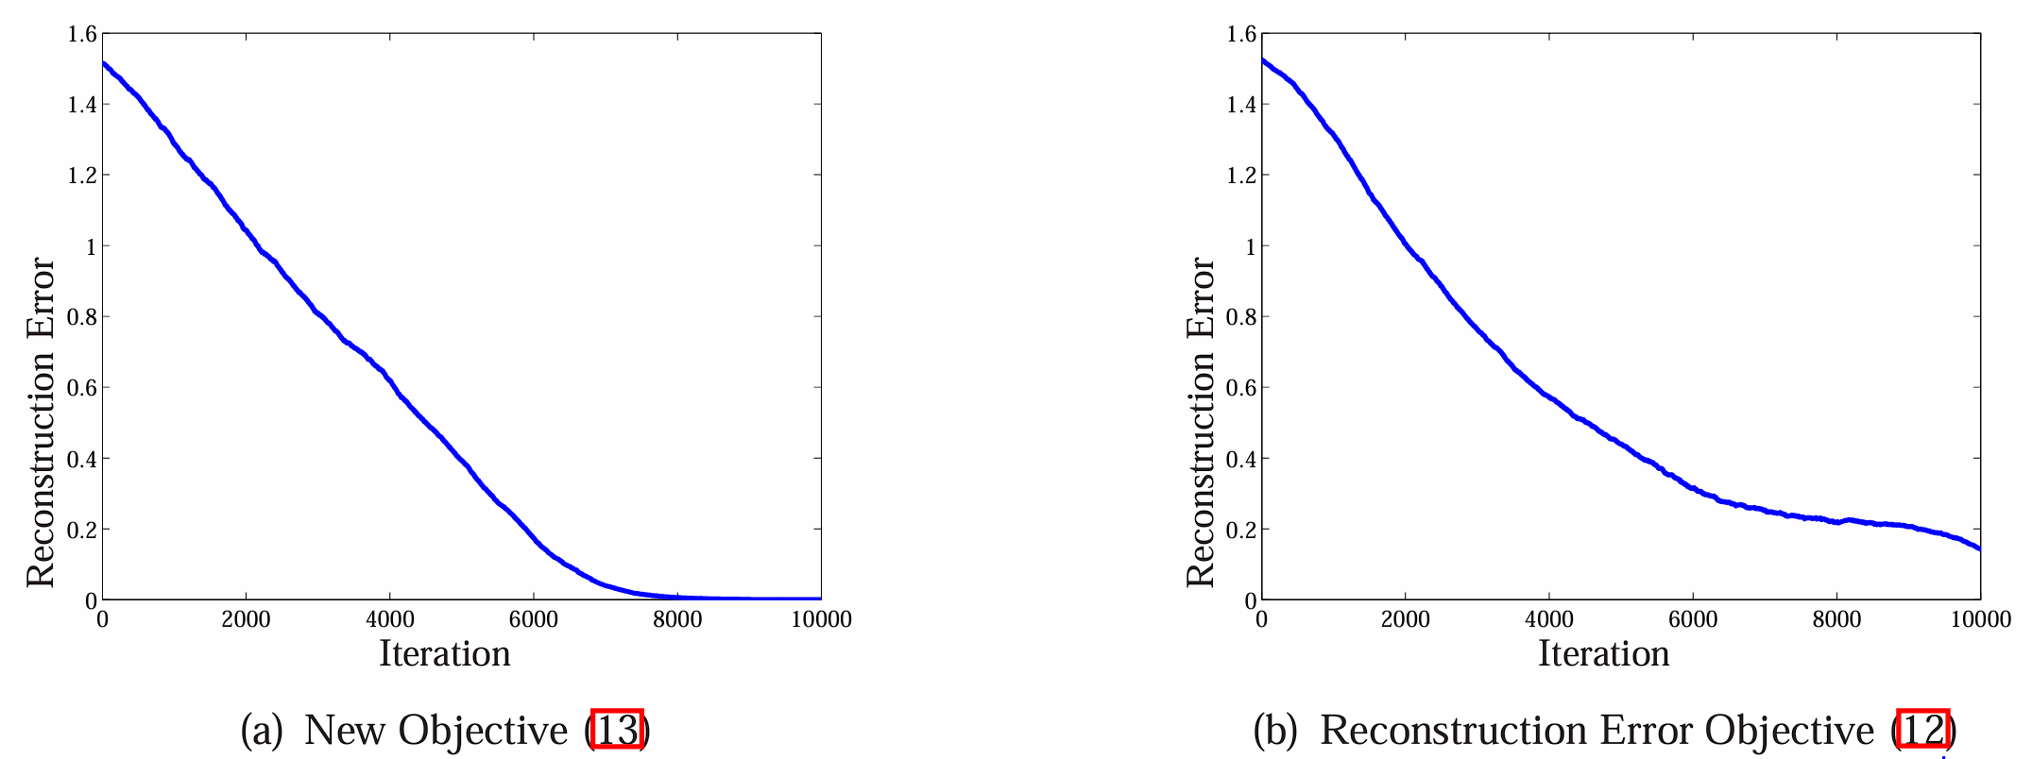
Experimental Outcome
A comparison of new and old objective versus iteration is given:
new objective function is empirically more stable (always converges within 10000 iterations); the reconstruction error do not always converge within the same number of iterations and often exhibits long periods with small im provement
高等机器学习 Advanced Machine Learning
机器学习 Machine Learning
滕佳烨 Jiaye Teng, 上海财经大学 SUFE

Slide 15
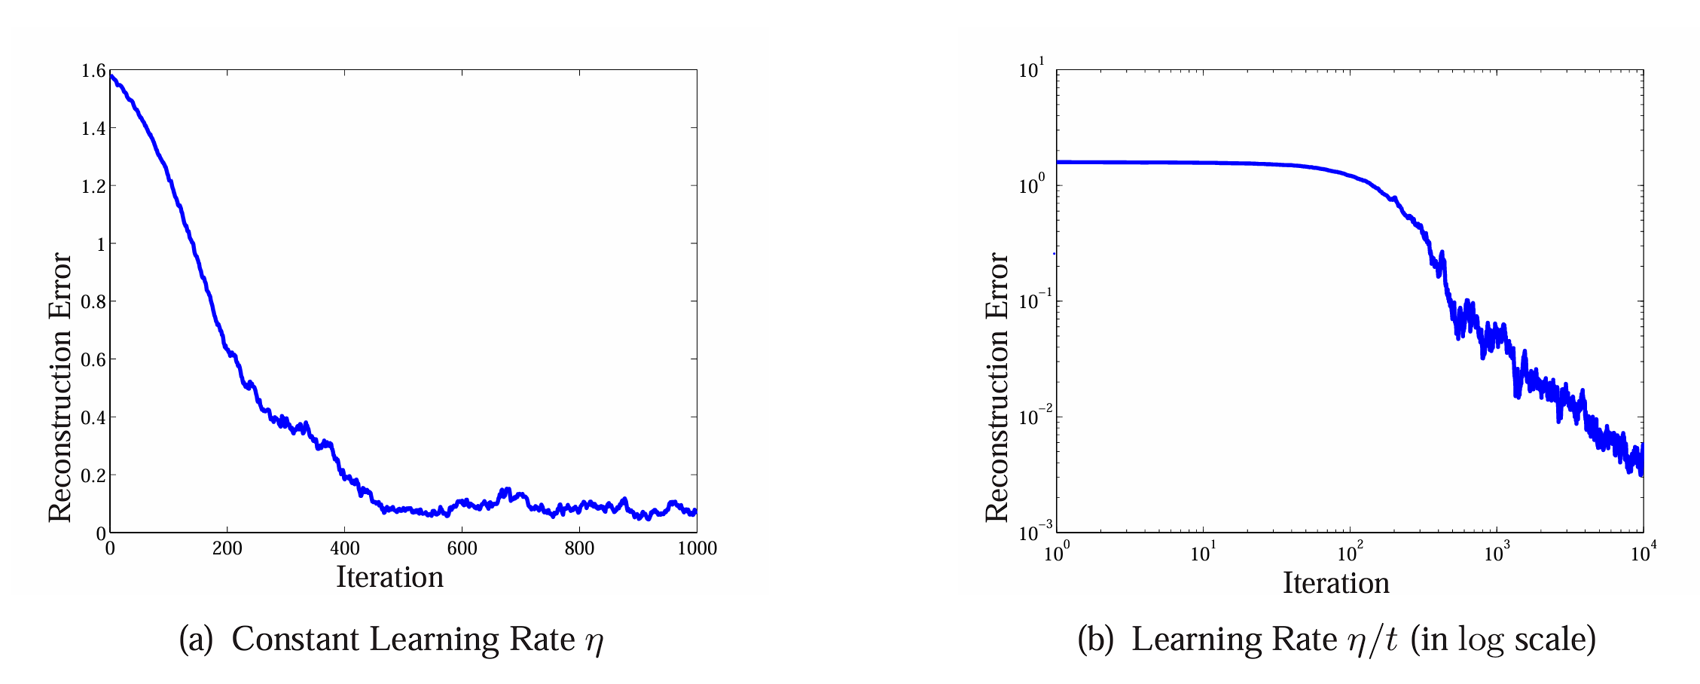
Experimental Outcome
For the non-convergence issue, can be solved by dynamicly adjusting the learning rate with iteration as (b) shows how error converges together with learning rate:
高等机器学习 Advanced Machine Learning
机器学习 Machine Learning
滕佳烨 Jiaye Teng, 上海财经大学 SUFE

Slide 16
Conclusion
Strength:
This paper provides one of the first rigorous, non-asymptotic analyses of how a first-order method can escape saddle points in non-convex optimization. With rigorous mathematical contribution together with practical test-benchmark
Limitation:
Practicality of the “Strict Saddle” property might be doubted, as it is a seemly demanding requirement.
Escaping the saddle is guaranteed by isotropic noise, which the simple construction of artificial noise might not suffice.
高等机器学习 Advanced Machine Learning
机器学习 Machine Learning
滕佳烨 Jiaye Teng, 上海财经大学 SUFE

